Slide 1
Smoking Trends in the US
Omaira Lopez
10/9/23

Slide 2
Smoking Prevalence by Age
What percentage of current smokers are between the ages of 50-80?
(Centers for Disease Control and Prevention, 2023)
Age Group (Years) | Percentage of Smokers
18–24 | 5.3
25–44 | 12.6
45–64 | 14.9
65 and older | 8.3

Slide 3
Percentage of all current smokers are Eligible for lung cancer screening
14.2 million Americans meet the US Preventive Services Task Force guidelines for screening (50-80, 20 pack years). (American Lung Association, 2022).
US population in 2022: 332,403,650.(U.S. Department of Commerce, 2022),
Groups | Percent of The Population
People Eligible for Lung Cancer Screens | 4.3
Rest of the Population | 95.7

Slide 4
Smoking Cessation Trends
What percentage of former smokers would quit in the last 15 years?
In 2015, 68.0% of adult smokers (22.7 million) said that they wanted to quit smoking.
In 2018, 55.1% of adult smokers (21.5 million) said that they had made a quit attempt in the past year.
In 2015, 31.2% of adult smokers (7.6 million) reported using counseling or medication when trying to quit.
In 2018, 7.5% of adult smokers (2.9 million) successfully quit smoking in the past year.
(Centers for Disease Control and Prevention, 2022)

Slide 5
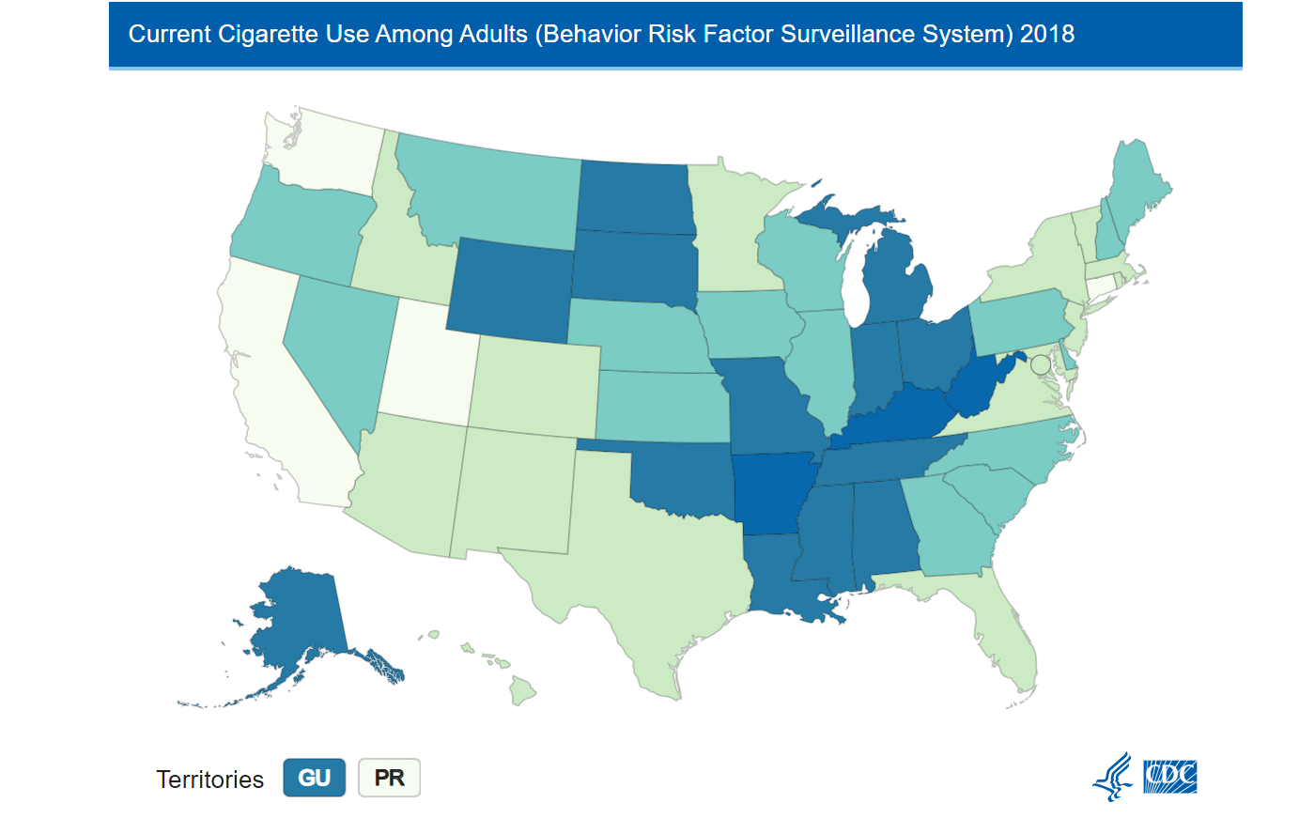
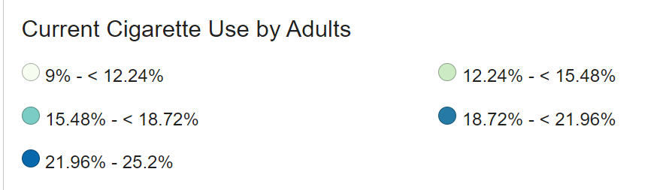
What is the range of percentages as they vary by state?
In 2018, current smoking ranged from nearly 9 of every 100 adults in Utah (9.0%) to 25 of every 100 adults in West Virginia (25.2%) (American Lung Association, 2022).

Slide 6
Current Cigarette Use Among Adults (2018)
Behavior Risk Factor Surveillance System
Location | Percentage | Low_Confidence_Limit | High_Confidence_Limit | Sample_Size
West Virginia | 25.2 | 23.6 | 26.8 | 4,810
Kentucky | 23.4 | 21.8 | 25 | 8,306
Arkansas | 22.7 | 20.9 | 24.5 | 5,177
Guam | 21.9 | 18.7 | 25.1 | 1,561
Indiana | 21.1 | 19.8 | 22.4 | 7,269
Tennessee | 20.7 | 19.1 | 22.3 | 4,909
Louisiana | 20.5 | 19 | 22 | 4,853
Mississippi | 20.5 | 19 | 22 | 5,674
Ohio | 20.5 | 19.4 | 21.6 | 12,405
Oklahoma | 19.7 | 18.2 | 21.2 | 5,060
Missouri | 19.4 | 17.9 | 20.9 | 6,100
Alabama | 19.2 | 17.9 | 20.5 | 6,347
Alaska | 19.1 | 16.9 | 21.3 | 2,698
North Dakota | 19.1 | 17.5 | 20.7 | 5,481
South Dakota | 19 | 17.1 | 20.9 | 6,913
Michigan | 18.9 | 17.9 | 19.9 | 9,953
Wyoming | 18.8 | 17.2 | 20.4 | 4,365
Montana | 18 | 16.5 | 19.5 | 5,076
South Carolina | 18 | 16.9 | 19.1 | 10,517
Maine | 17.8 | 16.6 | 19 | 10,693
North Carolina | 17.4 | 16 | 18.8 | 4,564

Slide 7
References
American Lung Association, (2022, November 15). New report: Critically low lung cancer screening rates reveal opportunity to save more lives. American Lung Association. https://www.lung.org/media/press-releases/state-of-lung-cancer-2022
Centers for Disease Control and Prevention. (2022, March 21). Smoking cessation: Fast facts. Centers for Disease Control and Prevention. https://www.cdc.gov/tobacco/data_statistics/fact_sheets/cessation/smoking-cessation-fast-facts/index.html
Centers for Disease Control and Prevention. (2023, May 4). Current cigarette smoking among adults in the United States. Centers for Disease Control and Prevention. https://www.cdc.gov/tobacco/data_statistics/fact_sheets/adult_data/cig_smoking/index.htm
U.S. Department of Commerce. (2022, January 6). U.S. population estimated at 332,403,650 on Jan. 1, 2022. https://www.commerce.gov/news/blog/2022/01/us-population-estimated-332403650-jan-1-2022

