Slide 1
Direct Primary Care: Evaluating a New
Model of Delivery and Financing by the Society of Actuaries
Prepared by Omaira Lopez
9/8/23

Slide 2
The Study:
Includes extensive 98 page report on:
  Data review of literature
  Market Review of DPC practices
  Case Study of DPC model as provided by a large employer

Slide 3
Market Survey Takeaways
Findings on survey of 200 DPC physicians:
The average per-person monthly DPC membership fees reported in the survey were $40 for children and ranged from $65 to $85 for adults, depending on age. Most DPC practices do not charge a per-visit fee for services covered under their DPC memberships (89%)
The average reported current DPC patient panel size was 445, while the average target panel was 628
Nearly all DPC physicians reported having better or much better “overall (personal and professional) satisfaction” (99%), “ability to practice medicine” (98%), “quality of primary care” (98%), and “relationships with their primary care patients” (97%) under a DPC model. Just 34% of DPC physicians reported having better or much better “earnings as a PCP under a DPC model.”

Slide 4
About Care Provided
Membership Covered Care | Covered with Additional Fee | Did not Offer the following
o Phone/text consults (99%) o Same-day appointments (99%) o EKG (88%) o Telemedicine (88%) o Urgent care/walk-in appointments (84%) 15 o Nutritional counseling (83%) o Weight management (82%) o Wellness coaching (79%) o Biopsy and excisions (70%) o Cryosurgery (65%) o House calls/home visits (58%) o Joint injections (58%) o Spirometry (56%) | o Basic laboratory testing such as HgbA1C, lipids, CMP, TSH, PSA, PAP, CBC, U/A (69%) o Sending off pathology specimens (66%) o Prescriptions drugs (57%) o Adult immunizations (53%) | o Flexible sigmoidoscopy exam (97%) o Obstetrical services (91%) o Vasectomy (88%) o Colonoscopy (82%) o Tympanometry (82%) o Ultrasound imaging (74%) o X-ray (74%) o Addiction medicine (73%) o Functional/integrative medicine (61%) o Department of Transportation (DOT) physicals (57%) o Endometrial sampling (57%) o Children and adolescent immunizations (51%)

Slide 5
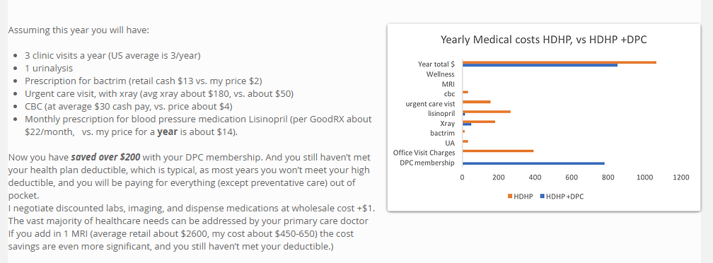
Individual Example of DPC
70% of today’s medical decisions depend on laboratory test results (CDC, 2018)
(Rhoads & Kray, n.d.)

Slide 6
About the Case Study
They procured a longitudinal claims data set from an employer with a DPC option included in its health benefits plan for employees and dependents over a 2 year period.
The health benefit plan covered approximately 1,000 employees and 1,000 dependents, and roughly half of the population was enrolled in the DPC option.
With this employer, members could elect to enroll in a traditional PPO-style plan option, or they could choose to enroll in an option that includes a DPC membership, with the employer covering the membership fee.

Slide 7
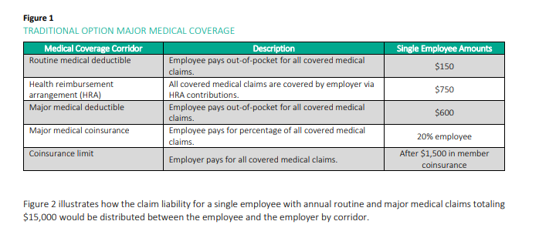
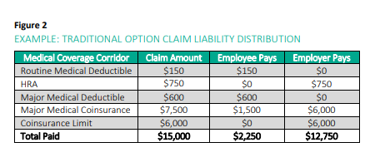
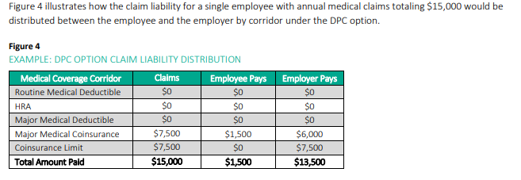
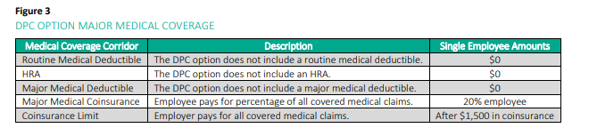
Price Breakdown for Employer and Employees
Figure 2 illustrates how the claim liability for a single employee with annual routine and major medical claims totaling $15,000
would be distributed between the employee and the employer by corridor.
Figure 3. Illustrates members enrolled in the DPC option had an alternate benefit structure versus the traditional option for coverage of non-preventive, traditional medical claims.

Slide 8
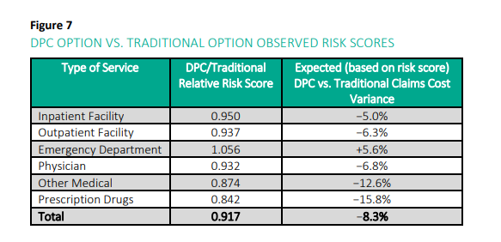
DPC Patients Utilization Analysis
Figure 7 provides a summary of the relative health statuses of the DPC and traditional cohorts based on risk scores.
Milliman Advanced Risk Adjusters™ (MARA™) calculates risk scores in total and broken out across six medical service types.
An individual with a higher risk score is generally less healthy and is associated with higher claim costs than an individual with a lower risk score.
These observed differences in health status between the DPC and traditional cohorts support the need for proper adjustments to be made when analyzing differences in actual utilization rates and claim costs between these cohorts.

Slide 9
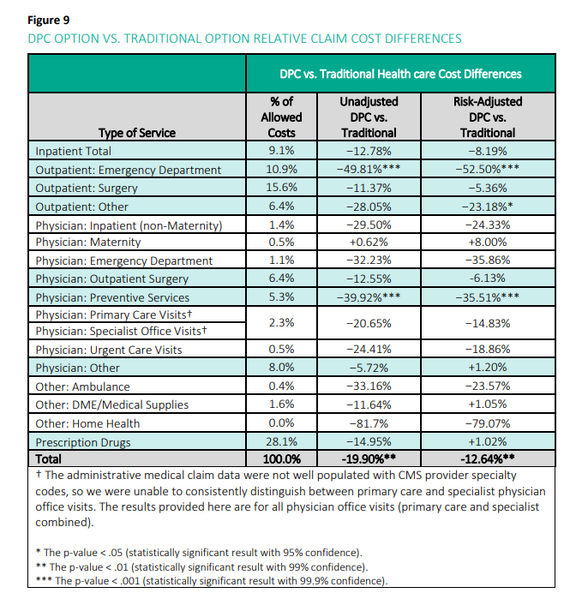
Claim Cost Differences
After adjusting for differences in health status, the DPC cohort experienced a statistically significant reduction in total claim costs relative to the traditional cohort during the same time period, meaning that enrollment in the DPC option was associated with a reduction in overall member demand for health care services.

Slide 10
Conclusions
The DPC option was associated with a statistically significant reduction in overall health care claim costs and emergency department usage after controlling for differences in age, gender and health status between the DPC and traditional cohorts.
The estimated health status of members choosing to enroll in the DPC option was more favorable than members enrolling in the traditional option.
Implementing a DPC option may be financially viable for employers self-insuring their health benefit plans. Depending on the baseline level of claim costs in an employer’s plan, how the DPC option is structured and the cost savings generated by the DPC delivery model, the introduction of a DPC arrangement could be done on a cost-neutral basis or may potentially lead to overall cost savings for the employer

Slide 11
References
Centers for Disease Control and Prevention. (2018, November 15). Strengthening Clinical Laboratories. Centers for Disease Control and Prevention. https://www.cdc.gov/csels/dls/strengthening-clinical-labs.html
Busch, F., Grzeskowiak, D., & Huth, E. (2020). (rep.). Direct Primary Care: Evaluating a New Model of Delivery and Financing. Retrieved September 7, 2023, from https://www.soa.org/globalassets/assets/files/resources/research-report/2020/direct-primary-care-eval-model.pdf.
Rhoads , P., & Kray, S. (n.d.). Cost comparisons. NoCo Primary Care DPC. https://www.nocoprimarycare.com/cost-comparisons

