Slide 1
Takeaways: Trends in
Direct
Primary Care
2022 by HINT
Omaira Lopez
9/22/23

Slide 2
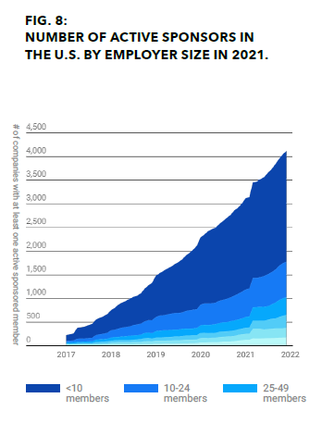
The Importance of DPC Reaching out to Employers
54.4% had health coverage through their employer.
A much greater number of smaller companies sponsor DPC than larger companies.
Companies with more than 250 enrolled DPC members constitute 57% of all enrolled, sponsored members yet make up only 4% of company sponsors.

Slide 3
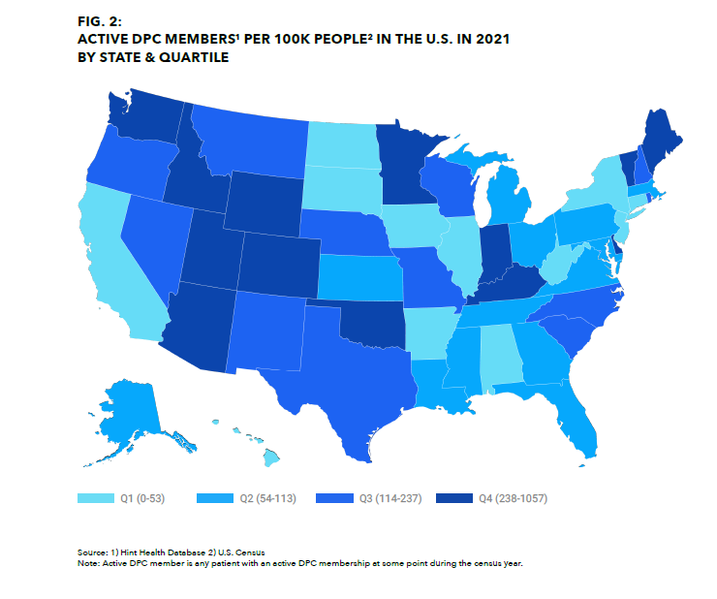
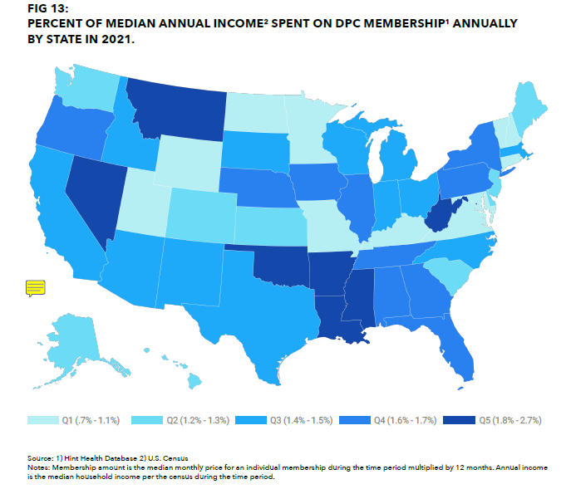
The Median Annual Income Spent Discrepancy
The places where most members are (Fig 2), are also spending the least per household income (Fig 13).

Slide 4
The Focus on Prevention Needs to be Evaluated
“Firstly, a cornerstone of primary care practice is the delivery of preventive care which compounds into better health and reduced costs over time”
AHIP Survey found that 53% of consumers reported preventive care is the benefit that matters most.
If the focus is on prevention; What happens with prevention for which additional fees are required? (i.e. Lung Cancer Screening)

Slide 5
Traditional Fee for Service’s Negative Impact on Primary Care
In Fee-for-Service model, physicians feel undervalued and poorly compensated.
This model is pushing physicians to specialize; resulting in the US having a ratio of generalists to specialists which is one of the lowest among the industrialized nations.
The number of PCPs entering and staying in the workforce is not keeping pace with population growth, resulting in a projected shortage of between 17,800 and 48,000 PCPs by 2034.

Slide 6
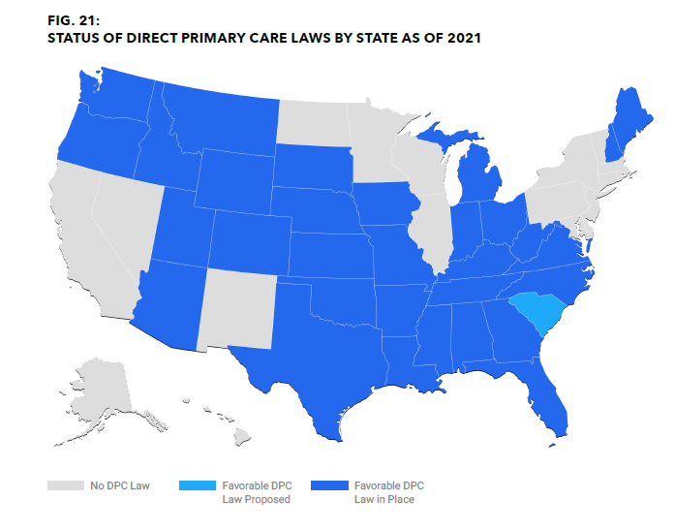
Legislature Favorable to DPC
The Primary Care Enhancement Act increases access to
affordable preventative and primary care by allowing
health savings accounts (HSAs) to be used to pay for
direct primary care. This enables patients to rely less on
specialists and hospital referrals.
State-level DPC legislation commonly seeks to clarify that a DPC arrangement is not an insurance product and thus not subject to state insurance regulations.
The number of DPC practices has grown more in States where legislature is more favorable for them- Nebraska is amongst one of such states.

Slide 7
Reference
Hint Health Inc. (2022). Direct primary care trends in 2022. Direct Primary Care Trends in 2022. https://get.hint.com/dpc-trends-2022

